Slide 1







Zomato Restaurant Expansion
Diksha Thakur
30/03/2025
Home Delivery

Slide 2

About Project
This Zomato Restaurant Expansion project focuses on finding the best locations for opening new restaurants by analyzing real restaurant data. Using Excel tools, I explored important factors like country-wise distribution, pricing, Cuisines, Ratings .
The project includes data cleaning, lookup functions, logical analysis , pivot table and creating an interactive dashboard to visualize insights. The goal is to support smart, data-driven decisions to help Zomato grow in areas with high potential and less competition.

Slide 3
Data Source
Two Tables:
Raw Data
Country Description
Attributes: 20 columns
Categorical Columns: 15 (like City, Currency, Has Online Delivery, etc.)
Cleaning Steps:
Missing "Cuisines" → filled with NA
Dates converted from strings to short date
Replaced "_" with spaces for consistency
Getting the structure and cleanliness right was crucial for accurate results.

Slide 4





Analytical Tools
LOOKUP
Pivot Table
To fill up country names by looking up in
The country description sheet according to country code
To filter out the Specific data like
Country names , cuisines , rating , price range etc. to use them as main criteria for analysis and dashboard building
Charts
Slicers
Charts to visually represent the
Data we are using for analysis
To easily manipulate the data according to
The countries we select

Slide 5

Data Enrichment using Excel
Added “Countries” column using VLOOKUP on country codes
Extracted year from "Opening Date" using =YEAR()
Created “Custom Price” column combining currency + cost
Highlighted target countries using Conditional Formatting
These small steps enabled deeper filtering and dynamic calculations later.
:-

Slide 6
Initial Insights from Data
🇮🇳 Restaurants in India with Price Range 4 → 388
Average voters per country using PivotTable
Created year-wise restaurant openings using the year column
Calculated average rating for:
Price < 4
Online Delivery = Yes
Using array formula (not conditional aggregation)
These give us a baseline understanding of trends across countries and pricing tiers.
:-

Slide 7
Recommended Countries for Expansion
Criteria Used:
Low competition (restaurant count)
High customer satisfaction (average rating)
Top Picks:
Qatar: 20 restaurants, 4.06 rating
Philippines: 22 restaurants, 4.47 rating
Indonesia: 21 restaurants, 4.30 rating
These three countries stood out when plotted on a combo chart (bar for count, line for rating).
:-

Slide 8
Recommended Cities in Target Countries
Philippines
Quezon City – 4.8★ (1 rest.)
Makati City – 4.65★ (2 rest.)
Tagaytay – 4.5★
San Juan – 4.25★
Indonesia
Tangerang – 4.3★
Bandung – 4.2★
Qatar
Doha – 20 restaurants, still scores 4.06★
We prioritized cities with few restaurants but high satisfaction. Philippines has the most promising diversity here.
:-

Slide 9
Other Important Insights
Country | No. of Restaurants | Avg. Rating
Philippines | 22 | 4.47
Indonesia | 21 | 4.30
Qatar | 20 | 4.06
Despite small market sizes, the customer experience is excellent — perfect for strategic entry.
Country | Avg Cost for Two (INR)
Indonesia | ₹1,462
Qatar | ₹5,056
Philippines | ₹9,962
Insights:
Indonesia → Most affordable
Philippines → Expensive, but people spend more
Qatar → Balanced value
If budget is tight, Indonesia is ideal. But Philippines offers high-spend returns.
:-

Slide 10
Top Competitors in Suggested Cities
Doha: Mainland China (4.9★), Gymkhana (4.7★)
Makati: Le Petit Souffle (4.8★)
Tangerang: Talaga Sampireun (4.9★)
Quezon City: Silantro Fil-Mex (4.8★)
These competitors can offer inspiration for ambiance and menu design.
:-

Slide 11
Cuisine Analysis
Top-Rated Cuisines:
Indonesian, Filipino, Sushi, Mexican (4.8–4.9★)
Indian (4.18★), Chinese (4.9★ in Qatar)
Country-wise Focus:
Indonesia → Sunda, Sushi
Philippines → Filipino, Korean, Mediterranean
Qatar → Indian, Chinese, Pakistani
High-rating cuisines in multiple restaurants mean a proven success pattern.
:-

Slide 12
Should We Offer Online Delivery / Table Booking
📌 Table Booking:
Little impact on ratings
Not present in most target markets
📌 Online Delivery:
Not available in any shortlisted countries
Ratings are already high without it
We can skip both services initially — they aren’t essential in these markets.
:-

Slide 13
Price vs Rating
Is Higher Cost Better?
Used CORREL formula between Avg Cost and Rating
Result = 0.314831 → weak positive correlation
Insight: Slightly better feedback at higher prices, but not a strong pattern
We should only charge more if the overall experience justifies it.
:-

Slide 14
Price Range Distribution
Qatar → Most restaurants in Price Range 4
Philippines → Balanced between 3 and 4
Indonesia → Mostly Price Range 3
We should match pricing strategy with local expectations. Mid-tier seems safe for entry.
:-

Slide 15

How I Created the Dashboard
Once the data was cleaned and enhanced, I began building an interactive dashboard using PivotTables and charts.
I inserted PivotTables to analyze:
Restaurant count by country and year
Average rating and cost
Cuisine preferences and service types
Then I created Pivot Charts for visual clarity and comparisons.
I added Slicers for Year, Country, and Price Range, so users can filter the view dynamically.
To display key numbers like average rating and total restaurants, I used helper cells
connected to pivots.
Finally, I formatted everything neatly with a Zomato-style theme.

Slide 16
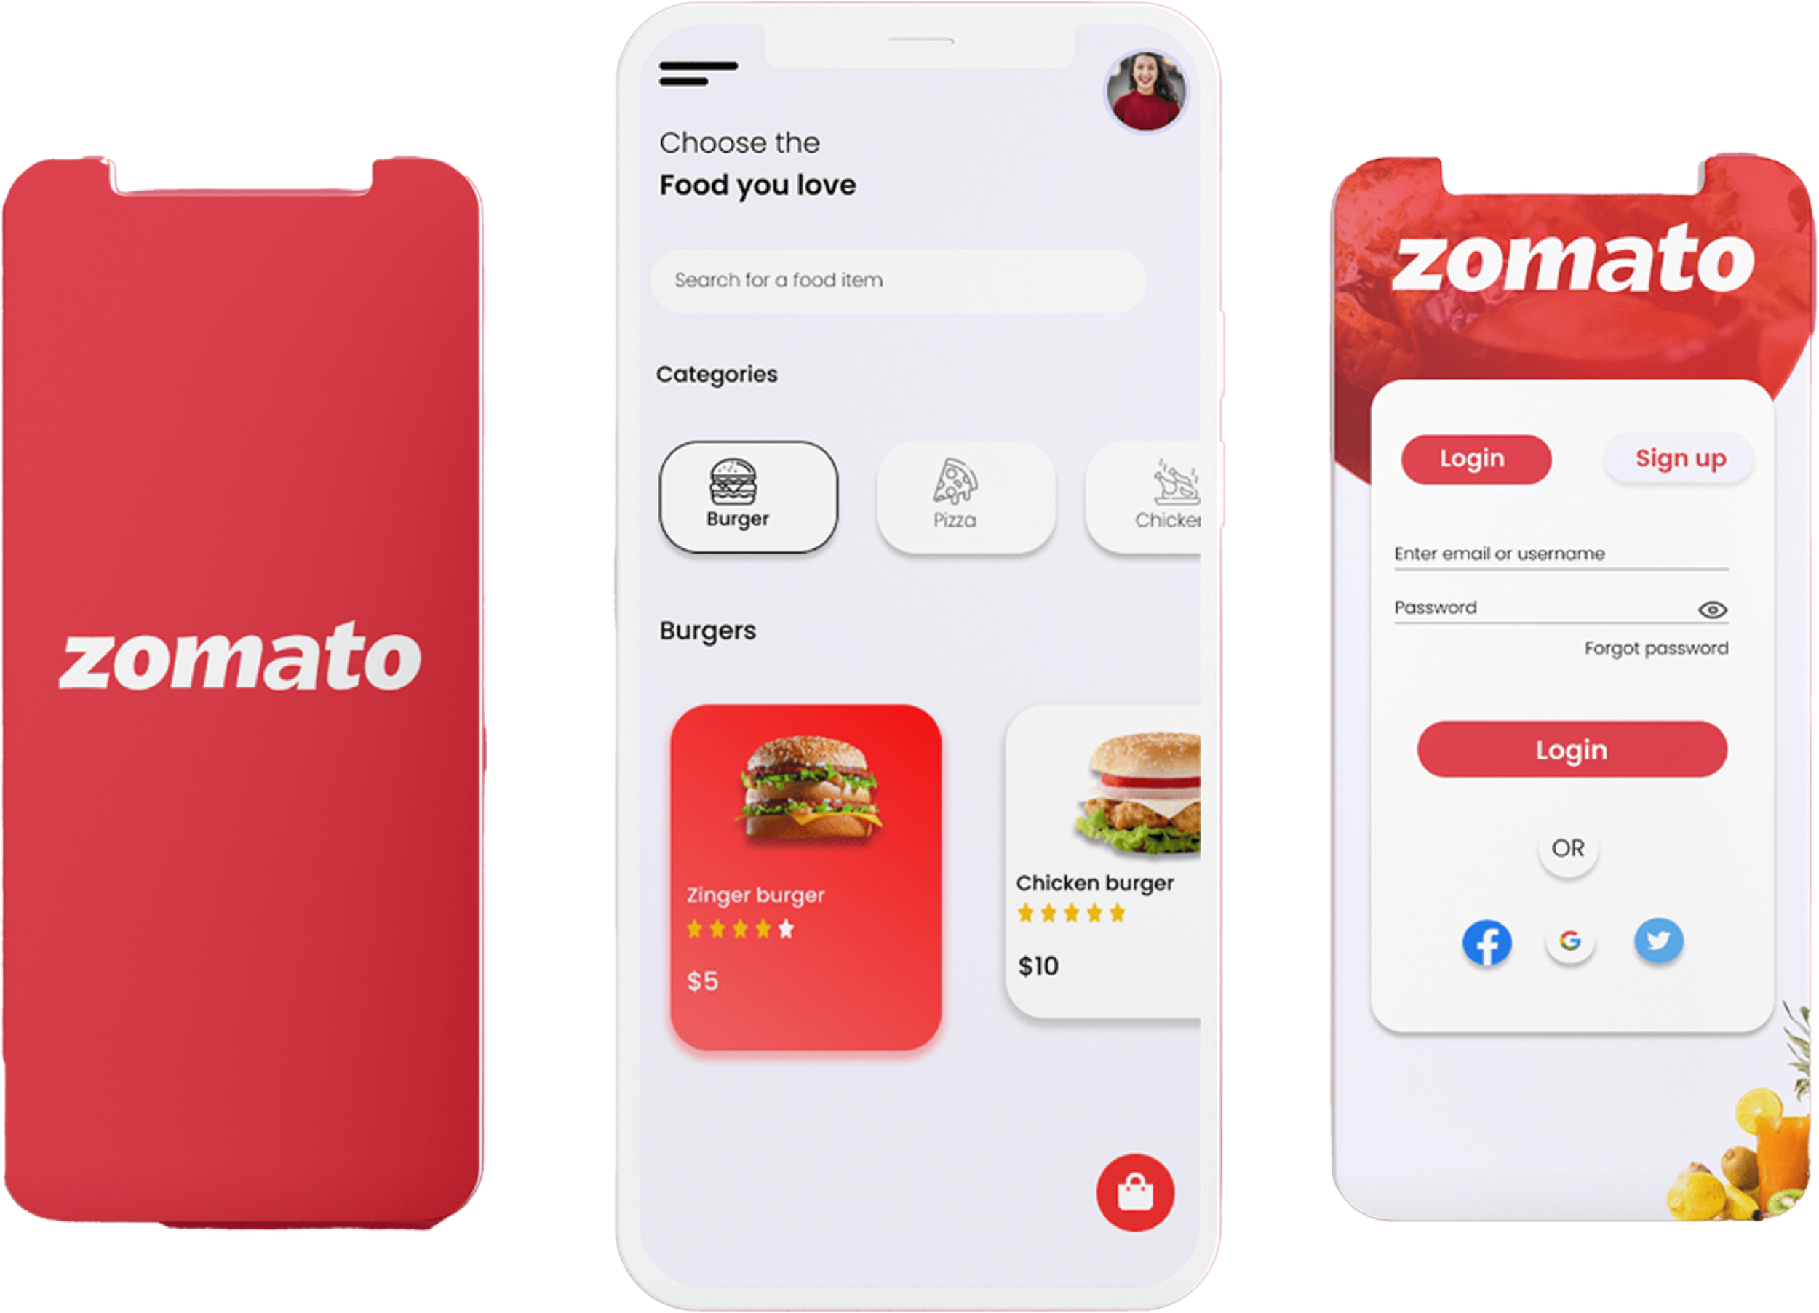
Dashboard Features
Slicers for year, country, and price range — fully interactive
Charts showing:
Restaurant trends by country/year
Price vs. rating
Cuisine performance
KPI cards for key stats:
Avg Rating
Avg Cost
Total Restaurants
Built to help Zomato quickly spot:
Underserved markets
High-performing cuisines
Smart expansion opportunities

Slide 17
Dashboard charts
Number of restaurants in each country
Trend of new restaurants opened per year
Avg. Customer Ratings by Country
Top Cuisines by Ratings
Avg. Cost for Two People by Country (INR
Percentage of Restaurants Allowing Table Booking
Online Delivery Availability Across All Restaurants

Slide 18
Number of Restaurants in Each Country
Insights:
India has the highest number of restaurants listed, followed by United States and United Arab Emirates.
Countries like Qatar, New Zealand, and Turkey have relatively fewer restaurants, offering potential for new market expansion.
The diversity of restaurant presence indicates Zomato’s existing global footprint, but also highlights untapped regions.
Recommendation
Consider increasing presence in countries with low restaurant count but potential for urban dining growth, such as Qatar and Indonesia.
:-

Slide 19
Trend of New Restaurants Opened Per Year
Insights:
The number of new restaurants added each year shows a fluctuating trend from 2010 to 2018.
There was a slight dip around 2014–2016, possibly due to market saturation or business constraints.
A steady increase is noticed again from 2016 to 2018, indicating renewed growth or expansion strategies.
Recommendation:
Maintain this positive growth by focusing on high-potential regions and cuisines, and improve platform services (delivery, booking) to attract more listings.
:-

Slide 20
Top 10 Cuisines by Average Rating
This chart displays the top 10 cuisines with the highest average ratings across all restaurants.
Helps identify cuisines that receive consistently positive customer feedback.
These cuisines are strong candidates for menu focus in new restaurants.
High-rated cuisines like Sunda Indonesian, Sushi, and Filipino show both popularity and performance.
Reflects customer taste preferences in our recommended countries.
:-

Slide 21
Average Customer Ratings by Country
Insights:
Philippines (4.46), Indonesia (4.29), and Qatar (4.06) have the highest average ratings, indicating strong customer satisfaction in these markets.
Countries with lower average ratings, such as India (3.76) and South Africa (3.48), may need quality or service improvements.
High ratings in low-competition countries suggest ideal locations for expansion.
Recommendation:
Focus on expanding into high-rating, low-saturation countries like Philippines, Indonesia, and Qatar, where customers already respond positively to food experiences.
:-

Slide 22
Average Cost for Two People by Country
Insights:
Qatar shows the highest average cost (~₹5056), indicating a premium dining market.
Philippines (₹2426) is mid-range, while Indonesia (₹1462) is the most affordable.
These cost levels reveal not just pricing trends but also potential customer purchasing power.
Recommendation:
In Qatar, position restaurants as premium brands offering high-end service.
In the Philippines, offer a balanced mix of value and quality.
In Indonesia, follow a cost-efficient, high-volume strategy.
:-

Slide 23
Percentage of Restaurants Allowing Table Booking
Insights:
Only 12% of restaurants allow table booking.
A significant 88% do not support table reservations, which limits convenience for dine-in customers.
This highlights a potential gap in customer service that can be improved.
Recommendation:
Encourage more restaurants to enable table booking features by:
Offering incentives or visibility boosts.
Providing a simple setup through the Zomato platform.
Educating partners on benefits
:-

Slide 24
Online Delivery Availability Across All Restaurants
Insights:
74% of restaurants offer online delivery, showing strong adoption.
However, 26% still do not offer delivery, representing a missed opportunity—especially in post-pandemic digital-first dining trends.
Recommendation:
Zomato should:
Target the 26% non-participating restaurants with onboarding campaigns.
Highlight the revenue growth potential and ease of integration.
Share data-driven case studies of delivery success stories.
:-

Slide 25
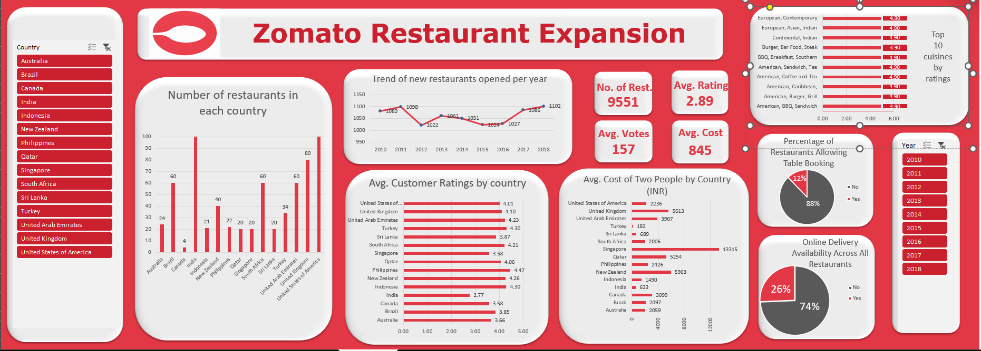
Dashboard of Zomato Expansion Project

Slide 26
Project conclusion
After exploring every angle — from ratings and cost to competition and cuisine — I arrived at these data-backed recommendations for Zomato's next move:
Recommended Countries:
Philippines, Indonesia, Qatar — all show high average ratings (4.06–4.47) with very low restaurant saturation.
Best Cities to Enter:
Quezon City, Makati, Tagaytay (Philippines)
Tangerang, Bandung (Indonesia)
Doha (Qatar) → These cities have high ratings and minimal competition.
Cuisines to Focus On:
Filipino, Sushi, Indian, Indonesian — consistently rated 4.5★+
Ideal Price Range:
Start with Price Range 3 to balance quality and affordability.
No Urgent Need for Online Delivery or Table Booking
Current markets thrive without them; they can be added later if needed.

Slide 27
Project conclusion
This was a solo end-to-end project — from cleaning messy data to extracting insights and building a functional dashboard.
Tools like VLOOKUP, IF, PivotTables, and CORREL helped uncover patterns hidden in thousands of rows of data.
My dashboard supports real-time exploration with slicers and KPIs — not just a one-time report.
Zomato now has a clear path forward to expand into markets where people are ready for new experiences — and where the competition hasn’t caught up yet.
“Backed by data, aligned with strategy — this isn’t just expansion. It’s smart expansion.”

Slide 28

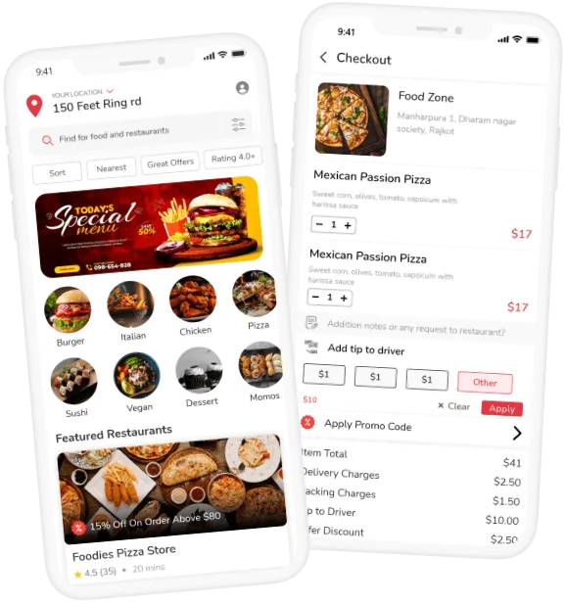
Thank You

